Slide 1

Professional Learning: Actionable Steps to Improve Quality and Content
Core Advocates Monthly Webinar
March 4, 2020
The webinar will begin shortly.
Check your Resource widget to preview the resources for today’s session! Use the Group Chat to introduce yourself!
Notes:
First timer poll
Handouts:
While we’re waiting, we’d like you to participate in a quick poll so we can get an understanding of who’s on the webinar with us tonight.

Slide 2
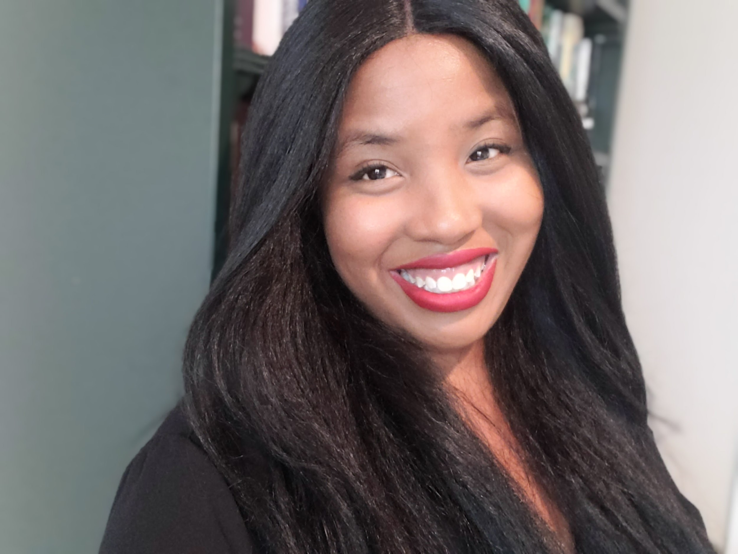
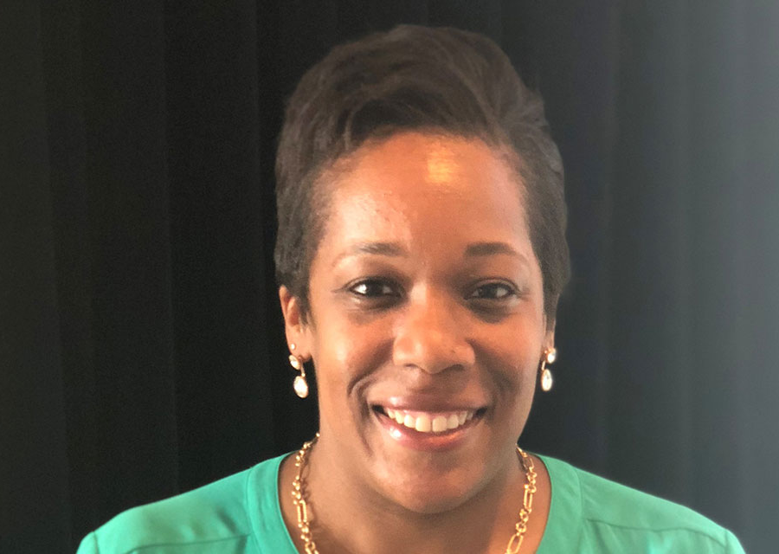
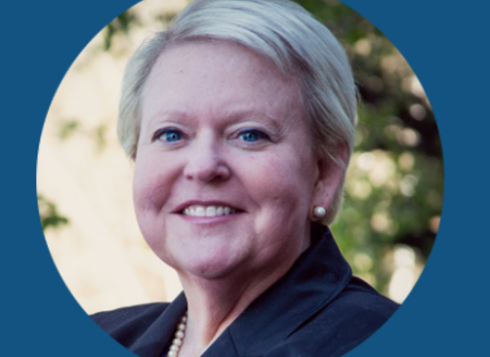
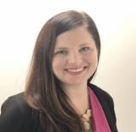
Introductions
Your hosts from Student Achievement Partners:
Pascale Joseph
Project Coordinator,
Tools and Classroom Resources, SAP
This month’s presenters:
Rachel Etienne
Vice President,
SAP
Robin McClellan
Supervisor of Elementary Curriculum & Instruction,
Sullivan County Schools, TN
Mandy Flora
Fellow, Teaching Lab

Slide 3
How many Core Advocate Webinars have you attended?
Please use the Questions tab on your control panel to respond.
If using a poll, please put up to 5 answer choices in the notes section below and indicate if attendees should choose only one response or multiple responses.
Notes:
It so good to see returning guests and so many new colleagues!

Slide 4
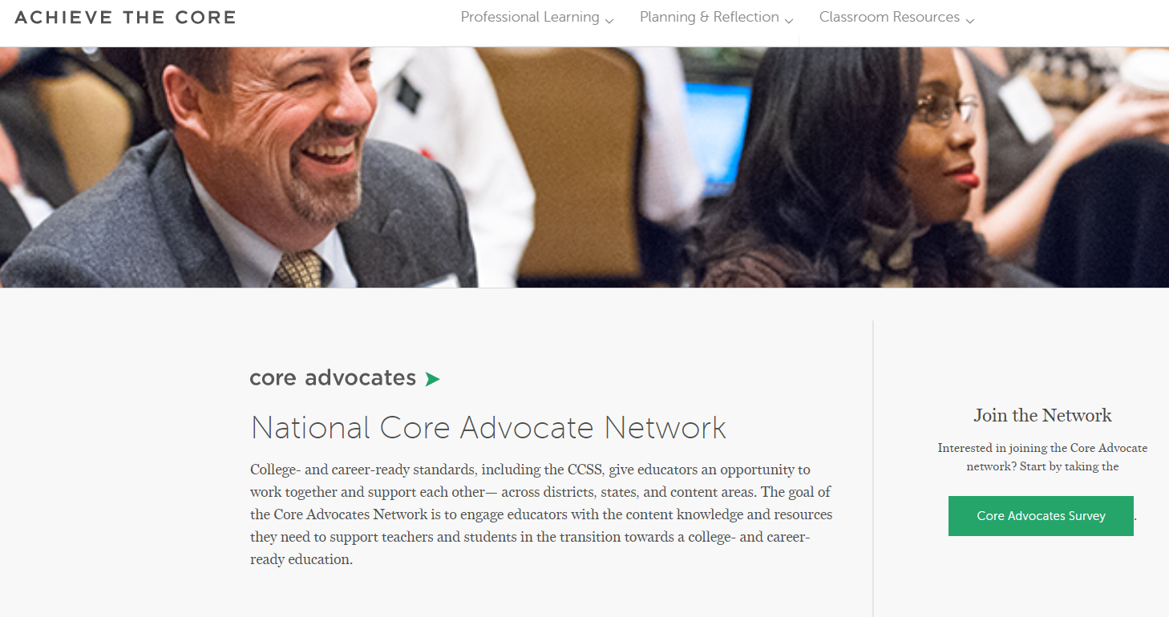
Join Our Network!
www.achievethecore.org/ca-signup
Notes:
If you find tonight’s webinar helpful, we’d like to invite you to join our Core Advocate network! We’re committed to solving real problems that real teachers have and we know the best way to do this is to know more about what folks are experiencing.
We’d love to learn about who you are, where you work, the types of things you’re interested in and the expertise you already have. This way, we will be able to tailor our webinars and other opportunities to your needs and interests (we may even tap you to be our next webinar panelist). So we encourage you to join the network by filling out this survey completely at atc.org/ca-signup

Slide 5

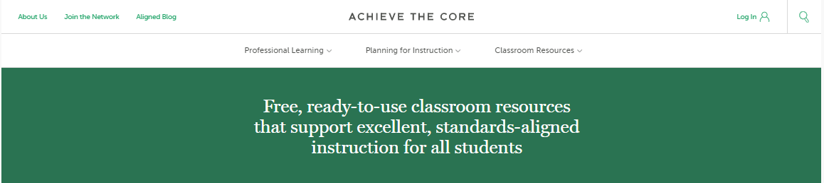
Learn More About Us!
Contact Jennie Beltramini (jbeltramini@studentsachieve.net )
Joy Delizo-Osborne
(jdelizo-osborne@studentsachieve.net)
Complete this survey to join our database (and mailing list): www.achievethecore.org/ca-signup
Visit our website: www.achievethecore.org
Notes:
If you’d like to learn more about the network, contact Jennie (her email is here).
We also want to invite you to join the network by signing up at achievethecore.org/ca-signup and visit our website for more info and opportunities

Slide 6

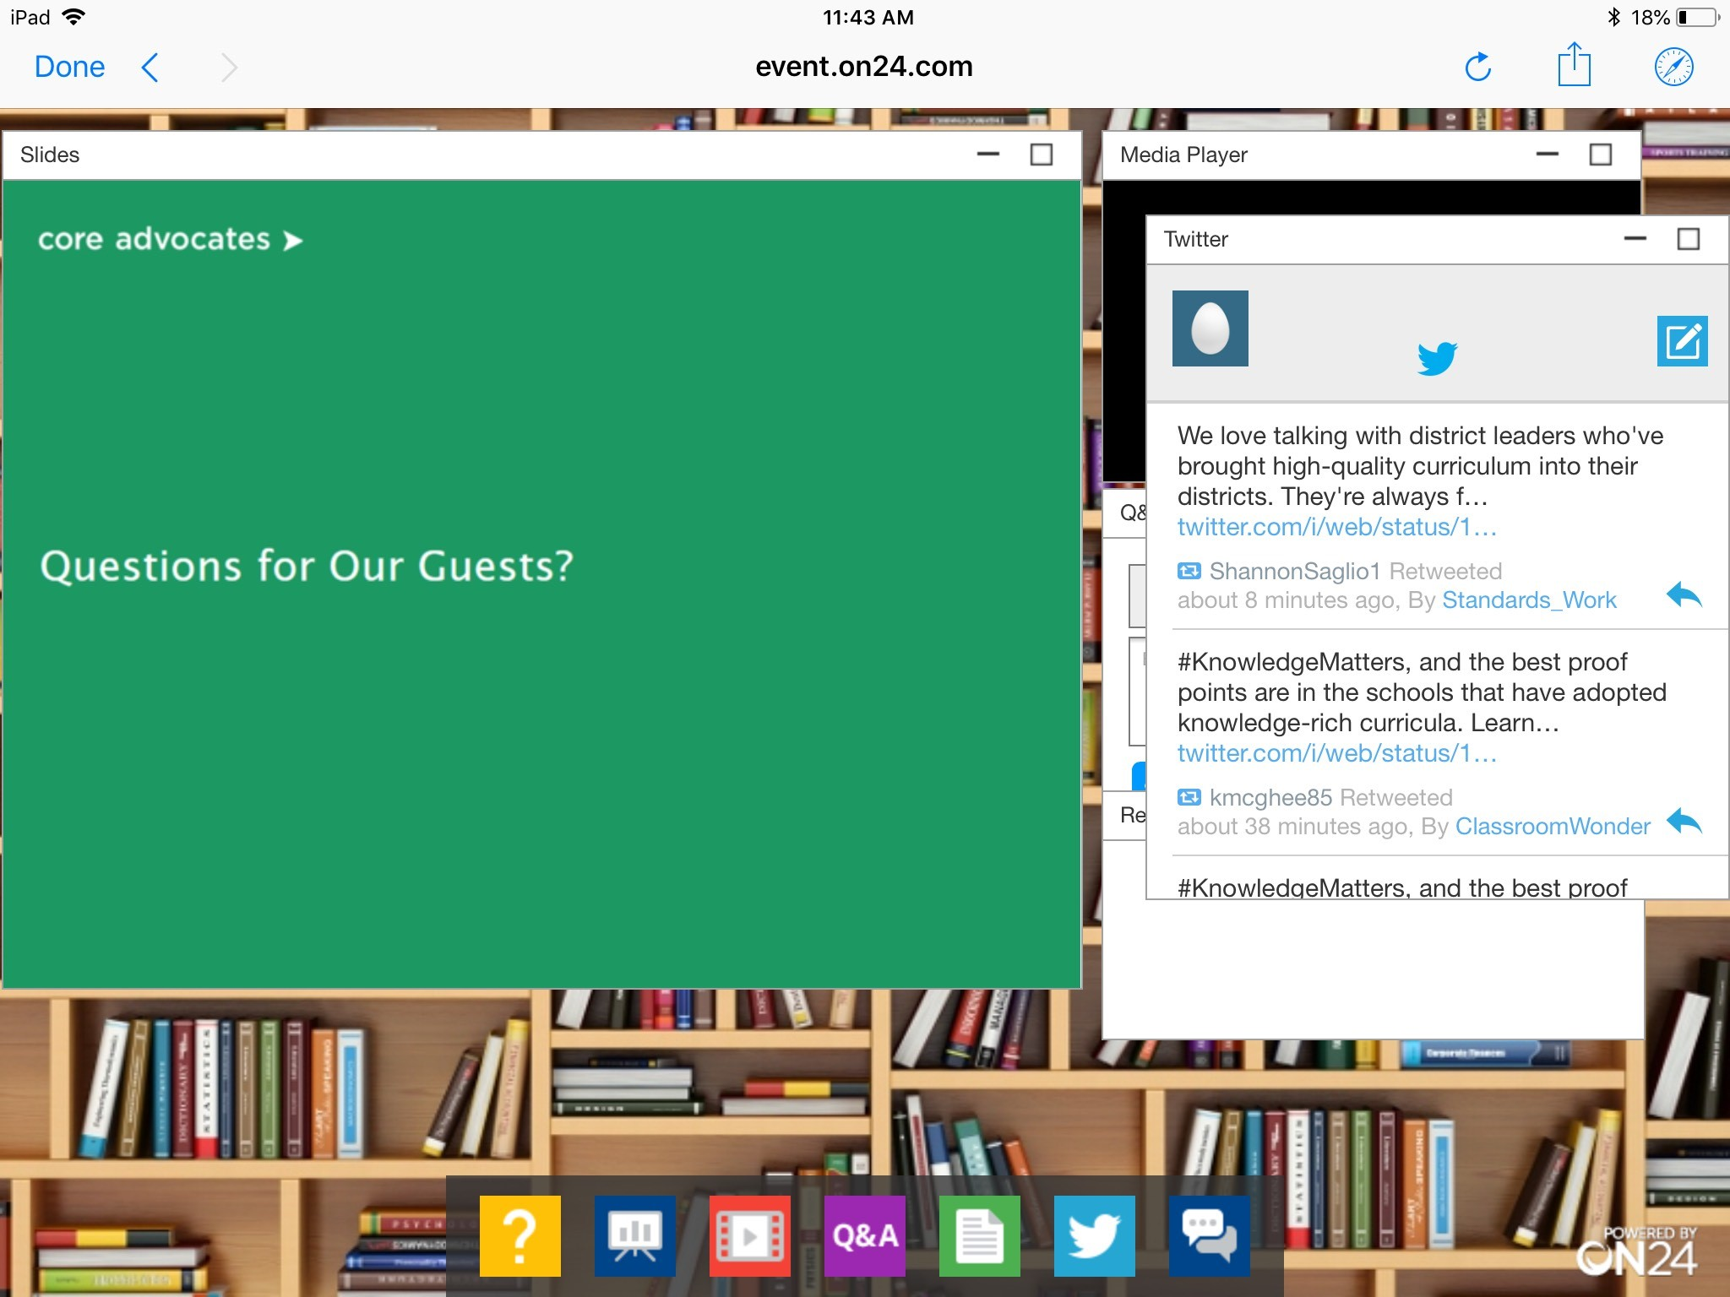
Tweet with Us!
Please feel free to tweet during and after the webinar using #coreadvocates
@achievethecore
@JennieBeltro
Click here!

Slide 7

Engage with Us!
During the webinar:
Question just for the presenters/ tech help
Resources
Group chat
After the webinar:
– Access to recording will be emailed to you.
Take our survey in 2 weeks and receive a certificate verifying 1 hour of professional learning.

Slide 8
Goals of the Webinar
Understand the current state of PL based on SAP’s research process
Learn about the creation and application of the Principles for High-Quality, Standards-Aligned Professional Learning
Get started with concrete ideas to improve professional learning
Notes:
We have three main goals for our webinar tonight. They are to...

Slide 9
Section 1: Why did we embark on this work?
Notes:
I’m going to share the process we took to develop this resource. Start at the beginning - why did we prioritize this work?

Slide 10
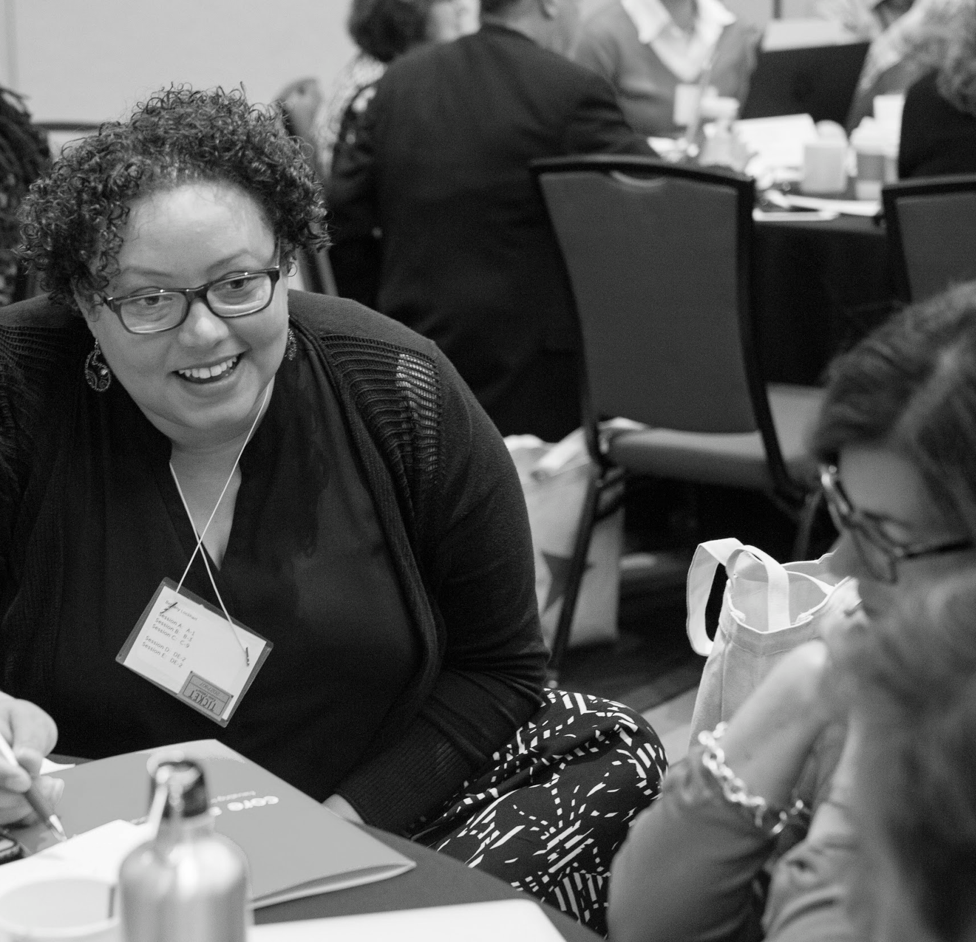
Why Professional Learning Matters
“Professional learning aligned to college- and career-ready standards has the power to improve instruction as well as student outcomes. But too often teachers are receiving incoherent professional learning that does not result in effective and equitable instructional practice or improved student achievement.”
-- Principles for High-Quality, Standards-Aligned Professional Learning
Notes:
On this slide, it’d be great to talk about the impetus for the project overall. Why did we even enter the professional space ?Why is this important to SAP’s mission.
Historically, SAP work focused on supporting implementation of CCR.
Always focused on learning and sharing research and evidence based models for implementing CCR
Professional learning as a priority through Core Advocates network
Educators have shared experience with PL and its not good.
With the presence of so many HQIM now available; there is both need and opportunity to rethink PL
What it takes to provide effective and equitable instruction for all students. What it takes to raise the bar in professional learning.
When was the last time you experienced game changing PL?

Slide 11
Question or Poll:
How often does professional learning change your practice?
Please use the Questions tab on your control panel to respond.
If using a poll, please put up to 5 answer choices in the notes section below and indicate if attendees should choose only one response or multiple responses.
Notes:
I can see from the results that your experiences resonate with what we learned over the last year while we investigated the “problem with PL”

Slide 12

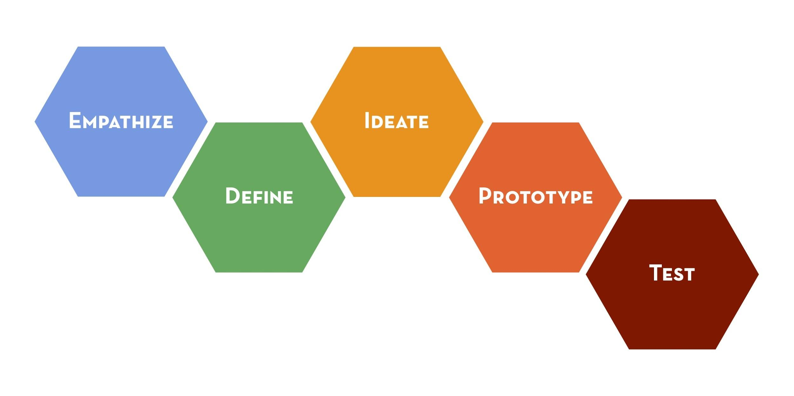
Our Process
Reviewed 200+ studies and articles
Collected feedback from partners & advisors
Conducted 50 empathy interviews
Problem: How might we define high-quality professional learning options, grounded in the best evidence, practice, and models of effective professional learning, for school systems that results in increased achievement for students facing barriers of racism or poverty?
Notes:
SAP had the pleasure of learning about equitable design through are partners at Equity Meets Design (ExD).
ExD encouraged is to think of ourselves as designers as well as educators and ensure that we are using and equity design approach as we address challenges and make decision.
This is an illustration of the equitable design process we undertook to ensure that we were creating something that would impact the people closest to the problem with professional learning - teachers!
We conducted 50 empathy interviews and reviewed hundreds of studies and articles.
We landed on this question we wanted to answer: How might we define high-quality professional learning options, grounded in the best evidence, practice, and models of effective professional learning, for school systems that results in increased achievement for students facing barriers of racism or poverty?
Here’s what we learned along the way.

Slide 13
First we asked educators...
WHAT DOES EFFECTIVE PROFESSIONAL LEARNING LOOK LIKE?
Notes:
As i mentioned….

Slide 14
Question or Poll:
Can you describe effective professional learning in one word?
Please use the Questions tab on your control panel to respond.
If using a poll, please put up to 5 answer choices in the notes section below and indicate if attendees should choose only one response or multiple responses.
Notes:
but first ...Can you describe effective PL in one word?

Slide 15

It should focus on relevant content...
Good professional learning keeps content at the center.
Professional learning should help me implement the curriculum I have.
The content of the professional learning sessions has to be ultra relevant – which means both timely and related to what’s happening in the classroom.
Professional learning shouldn’t be a framework or set of protocols that are separate from the existing instructional priorities of my school.
Notes:
Keeps my subject area or better my curriculum at the center of PL. I teach 8th grade math! Help me implement these lessons!
It has to impact the reality of my classroom. I have two new students, how can I incorporate strategy for multi-lingual learners?
It’s also confusing if information I learn in PL doesn't jive with the priorities and practices of my school

Slide 16
It should focus on teachers and students...
There should be a grassroots approach to planning professional learning to ensure that the time is spent in ways that will be most impactful for teachers.
Start with what the school needs--what teachers and students need. Then create an action plan for how to get there--that's good professional learning.
Teachers and school leaders need to carry the cognitive load so that they can build meaning for themselves.
Helpful professional learning meets teachers where they are and moves us forward.
Notes:
So many shared wanting to have a say in what professional learning will matter most for me and and my students.
Respect me as an professional, make me think, challenge me and my students to grow.
At the end of the day, I want to do what will help my students the most.

Slide 17
Learning is immediately actionable...
Professional learning needs to make connections to how the learning is relevant to day-to-day life in the classroom and the needs of students.
The majority of professional learning should happen at the school level, embedded in practice in an ongoing way.
Good professional learning creates an arc of learning that ties to what should happen in the classroom throughout the year.
I want to leave professional learning saying "I can use this tomorrow."
Notes:
Access to ongoing support at the school level is critical - things like coaching stood out
Meets the needs of my students and adapts to the evolving content of my curriculum over the course of the school year.
As my students become more independent readers, what can I do to remove scaffolds that were necessary earlier in the school year?

Slide 18

We looked at existing research
IT AGREED
Notes:
Research reinforced so much of what we heard from practitioners

Slide 19

Building Ongoing and Sustained Professional Development. In Teaching Science in the 21st Century
Jack Rhoton and Brenda Wojnowski, 2006.
"Effective professional development must focus on student learning and educator needs, engage and challenge science educators, be sustainable over time, be an interactive activity, be content-specific and collaborative, and integrated with other school initiatives."
Notes:
Effective PL must keep student learning is the end goal. PL is only effective if it results positive in changes for students.

Slide 20
"For all of these people, professional learning is central to their jobs. It is not an add-on. It is not something done on Friday afternoons or on a few days at the end of the school year. Teacher professional learning is how they all improve student learning; it is how they improve schools; and it is how they are evaluated in their jobs. They work in systems that are organized around improvement strategies explicitly anchored in teacher professional learning."
Beyond PD: Teacher professional learning in high-performing systems.
Ben Jensen, Julie Sonnemann, Katie Roberts-Hull and Amélie Hunter-- National Center on Education and the Economy, 2016
Notes:
Ben Jensens and his team at Learning First reported that in high-performing school systems effective PL is seen as:
essential to the job of improving student learning.
It’s not an add on or extra money to spend at the end of the year

Slide 21
"Let’s bring in our teachers as partners to create:
Let’s give them the time, the structures, the support, and the choices they need to be fully engaged in improving practice and solving our most pressing educational challenges. When we believe in our teachers, listen to them, and support their continual development, there is no telling what our educators and their students will accomplish."
Moving from compliance to agency: What teachers need to make professional learning work.
Laurie Calvert, 2016
job-embedded, authentic systems of learning for the whole school community.
Notes:
Laurie Calvert found that in effective PL:
Teachers as partners to plan PL that matters to reality of the job.
Time is consistently an issue. PL time is precious and should pay off in reality day-to-day of teachers jobs.

Slide 22
Culturally responsive teaching matters!
Elizabeth B. Kozleski, 2010
"This is no small matter because it requires that teachers transcend their own cultural biases and preferences to establish and develop patterns for learning and communicating that engage and sustain student participation and achievement."
Notes:
Effective PL
addresses cultural bias in practice and materials.
engage in research-based content focused pedagogical knowledge (like facilitating math talks, structuring writing tasks) AND
also the social and emotional elements involved in learning and communicating.

Slide 23
But what works, isn't always happening.
Notes:
These evidence-based practices need to become more widely-accepted and replace some our our tried and true “best practices”

Slide 24
Question or Poll:
What is the most consistent challenge you’ve encountered in professional learning?
Please use the Questions tab on your control panel to respond.
If using a poll, please put up to 5 answer choices in the notes section below and indicate if attendees should choose only one response or multiple responses.

Slide 25

When it is done, and I have to search for nuggets I can use. It’s one-and-done; no follow through.
The culture of schools is that they operate on the mentality of the “daily crisis” making it difficult to devote time and attention to professional learning.
PL often does not apply to my work or connect. I won’t be able to go and change my practice because of it.
How do we get everybody on the same page? Districts where leaders show up to PD; where they provide the most support, that’s where we see change. If that’s not present, change is hard.
There is no content-specific training to help teachers learn more about their subject unless they go to an external conference.
Notes:
Here’s what we heard before and I see similar thoughts in the group chat.

Slide 26

The goal is to create PL experiences that change instruction to improve student outcomes…
So what do we need?
Notes:
Remember PL can only be described as effective if it result positive outcomes for students. First stop ineffective practices. Sometimes harder than starting to do things.

Slide 27
Section 2: What do we need to improve the quality and content of Professional Learning?
Notes:
to build toward effectiveness...

Slide 28
Even though professional learning doesn't have to look the same...
CERTAIN THINGS MUST BE TRUE FOR IT TO BE EFFECTIVE
Notes:
From school to classroom to district or state, PL takes many forms - coaching, PLC groups, workshops, lesson studies, etc.
What must be true no matter what based on the research and what people say actually works for them.

Slide 29
We need a set of non-negotiables...
THAT ARE TRUE OF ALL HIGH-QUALITY, STANDARDS-ALIGNED PROFESSIONAL LEARNING EXPERIENCES
Notes:
With the information we gathered from talking to folks and reading the research we identified 3 principles for the design and delivery of PL

Slide 30

Principle 1
Professional learning builds teachers’ content knowledge and pedagogical content knowledge necessary to teach the concepts of their discipline.
Notes:
Each principle includes 4 -5 descriptors of effective practices that reflect that principle.
For example, You’ll get more information about the features of content-focused effective pL across disciplines

Slide 31

Principle 2
Professional learning promotes collective responsibility for students’ learning and cultivates a dynamic culture for adult learning.
Notes:
A motivating culture where Teachers & students at the center, however all adults are in support of student learning across roles.

Slide 32
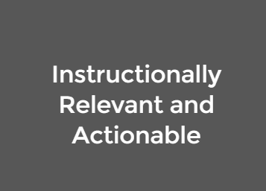
Principle 3
Professional learning is anchored in the instructional priorities of teachers’ daily work and is sustained in a coherent system of collaborative planning, classroom practice, observation, feedback, and continuous cycles of inquiry grounded in evidence of student learning.
Notes:
Rinse and repeat effective practices. Remove ineffective practices, barriers or distractions to work the matters most.

Slide 33
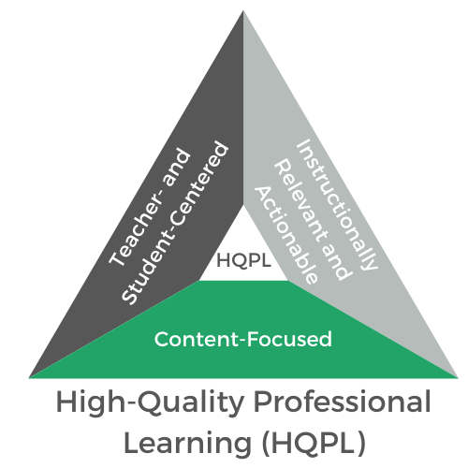
All three Principles need to be reflected to be effective
Notes:
Principles are not a checklist where some things can be present and some not.

Slide 34
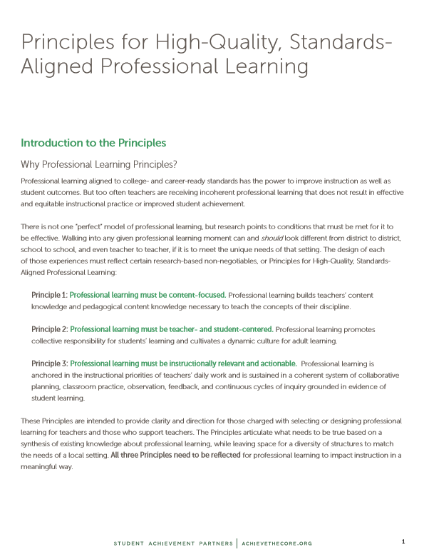
Principles for High-Quality, Standards-Aligned Professional Learning
Introduction “the why”
Principles
“the how”
Notes:
Encourage you to share and discuss this document in your systems.
Where do you see promising practices? What might you need to stop doing? What could you start doing to improve the quality and effectiveness of PL?
That’s where we’re heading next in our session today. What could you start doing to improve the quality and effectiveness of PL in your setting?

Slide 35
Question or Poll:
Describe your role when it comes to professional learning. Are you a recipient, designer or facilitator of professional learning?
Please use the Questions tab on your control panel to respond.
If using a poll, please put up to 5 answer choices in the notes section below and indicate if attendees should choose only one response or multiple responses.
Notes:
So many entry points to get started on this complex work!

Slide 36
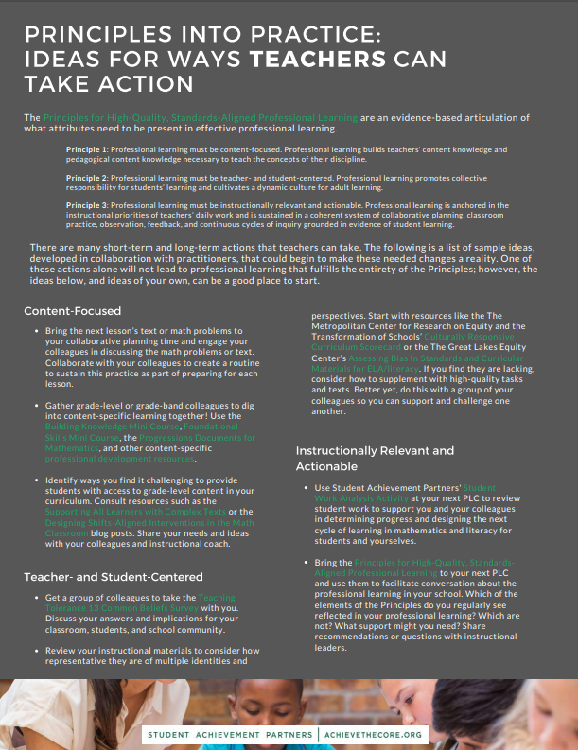
What does this all look like in practice?
Whatever your role, there are ways to take action
Notes:
Resources with ideas for how you can start improving PL tomorrow.
Examples
teachers - Gather grade-level or grade-band colleagues to dig into content-specific learning together! Take the Foundational Skills Mini Course, or dig into the Progressions Documents for Mathematics
coaches - Create routines to do the math or read the text for every upcoming lesson with the teachers you support. Collaborate to design instruction for those problems or text.
school leaders - Set the expectation that all adults in the school building will hold positive views of students’ capabilities. Model this expectation through your words and actions and hold others accountable for their words and actions.
district - Develop and enact strong processes for vetting the professional learning content, including content from external providers to ensure it connects to the instructional vision and academic priorities of the district
State - Spotlight best practice across the state so districts can learn from one another and share innovative and equitable instructional practices and policies.
Download now for concrete resources to share and try with your colleagues.
Today…. We have the pleasure of hearing from two folks living these principles in their roles and in their local settings.
Robin is a district leader leading efforts to implement a district-wide adoption of CKLA
Mandy was a teacher leader who received high-quality PL and now works with others to spread the love.

Slide 37
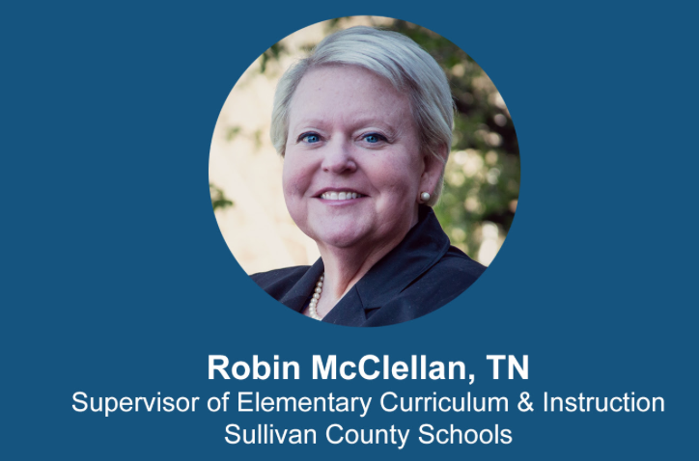
Sullivan County Schools
Rural district in Northeast Tennessee
District of 9,000 students
Eleven elementary schools (all Title I)
Spring 2016
Fall 2016
4 Year Journey
Moment of Impact
The Literacy Revolution Begins
Today
K-2 walkthroughs using the Instructional Practice Guide: 6% of observed lessons showed full alignment to TN standards.
24 pilot K-2 teachers in 3 schools began using HQIM.
Increased achievement.
Increased student engagement.
Equity through high expectations.
#Work-in-progress.
Notes:
Robin

Slide 38
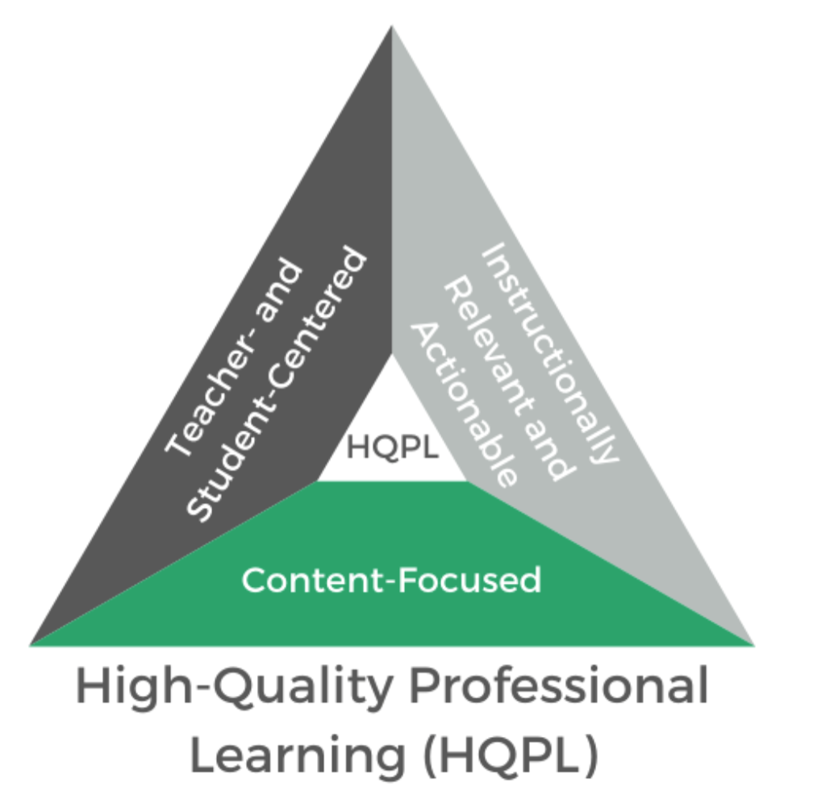
From “Willy Nilly” to Strategy Grounded in the Principles of HQPL
Professional learning is teacher- and student-centered
The “NO SHAME ZONE” is a gamechanger: teachers and leaders must feel safe to be vulnerable in their unfinished learning.
Teachers voice informs strategy.
  Solve problems of practice
  Unit and lesson prep
  Learn a targeted skill as tied to the IPG
  align written tasks and assessments
Student work/data informs strategy.
Student strengths and needs inform strategy: expectations and equity.
Professional learning is instructionally relevant and actionable.
Teachers join together as grade level literacy teams from across the district.
Using a parallel PL model, leaders learn the same content so they are equipped to support teachers in their buildings.
  Use the IPG walkthrough tool focused on a particular Core Action
  Provide teachers with their “one next best step”
  Facilitate grade level literacy PLCs weekly for support and next step conversations
Professional learning is content focused.
All PL is grounded in the science of reading,
All PL is grounded in the implementation of our HQIM and how teachers apply the “art of teaching” to the strong foundation (“science of teaching”).
All PL is grounded in the belief that “they will rise”
Notes:
Robin:
New curriculum meant we had to change the way we do professional learning

Slide 39
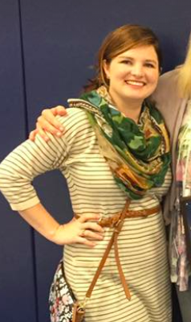


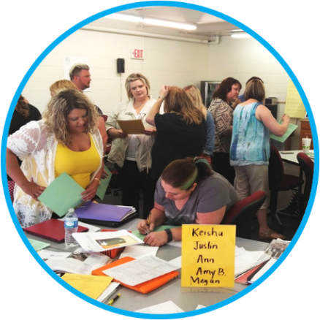

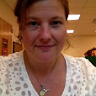
The WV Teaching Lab just kept growing.
Founding Group
Growth
New leaders Emerge

Slide 40




Teaching Lab’s model is based on three research-based elements.
Head
Core Academic Content
Heart
Teacher Community & Leadership
Habits
Sustained Cycles
of Inquiry
Acquired techniques ineffective/
counterproductive
Pedagogical content knowledge doesn’t grow
Low buy-in/ resentment
Resistance to adoption
Not incorporated into regular practice
Not verified with student learning

Slide 41
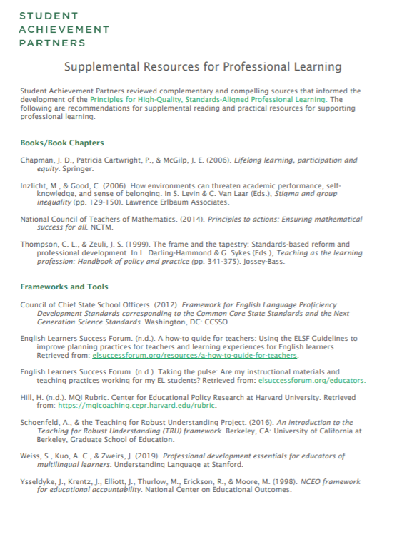
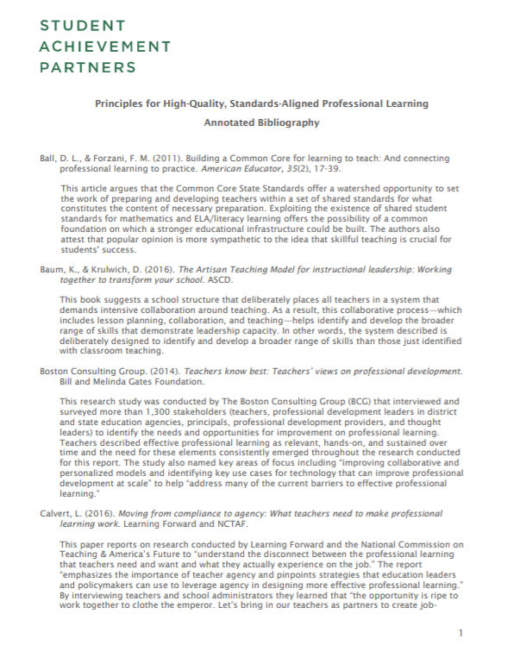
Additional Resources
Supplemental research and tools
Annotated Bibliography
Notes:
Thank you to both Robin and Mandy for sharing your experience. In just a moment we will open for questions for our guests.
In addition to the resources we looked at already there are More
Examples:
supplemental is the UL Professional Development Essentials created to assist schools, school districts, state or county offices of education, and professional development providers as they design well-balanced professional development plans for educators of multilingual learners.
Annotated Bib - makes the research available for learning and supporting effective and equitable instruction and system policies
State reached out recently to access the annotated bib as they developed a research brief for funding pL work

Slide 42

Download the Principles from achievethecore.org today!

Slide 43
Questions for Our Guests?

Slide 44
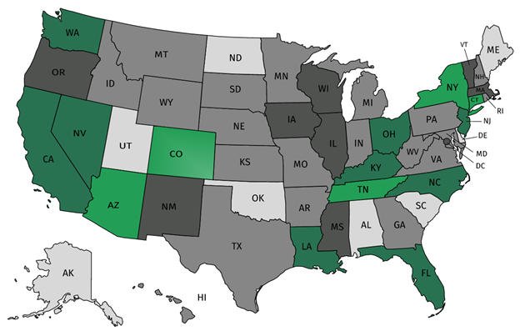
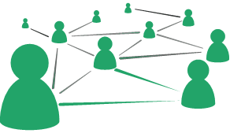
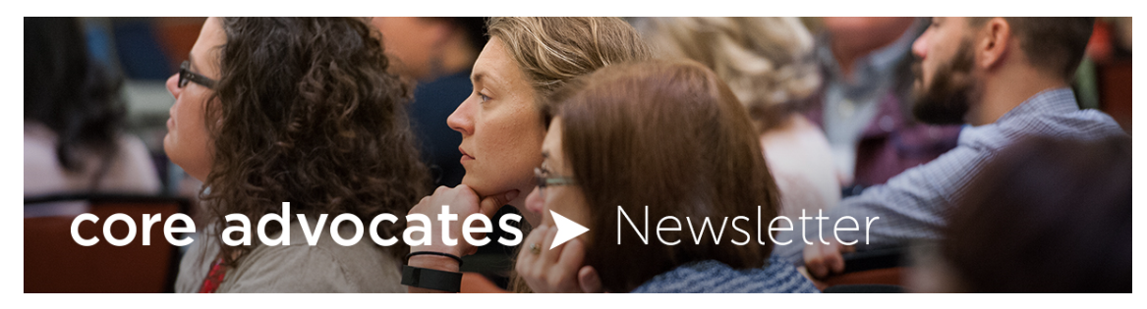


Join our network!
Join a national network of educators
Connect with state networks
Be a part of creating new tools and resources in partnership with SAP
Keep up to date on free resources, upcoming SAP webinars/professional learning opportunities, job postings and more!
Notes:
If you found tonight’s webinar helpful, we’d like to invite you to join our Core Advocate network! We’re committed to solving real problems that real teachers have and we know the best way to do this is to know more about what folks are experiencing.
As part of our national network, you have opportunities to connect with educators across the country, maybe even the network in your state! You can keep up to date on tools and resources available on Achieve the Core, as well as a variety of virtual learning opportunities and other ways to engage with us. We also work with educators in our network to help us build tools and resources.
We’d love to learn about who you are, where you work, the types of things you’re interested in and the expertise you already have. This way, we will be able to tailor our webinars and other opportunities to your needs and interests (we may even tap you to be our next webinar panelist).

Slide 45




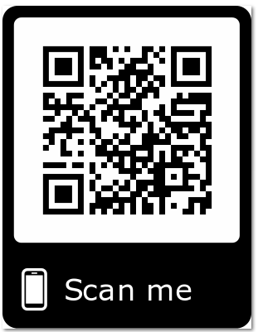
Please Join Us!
https://achievethecore.org/ca-signup
Twitter: twitter.com/achievethecore
Facebook: facebook.com/achievethecore
Pinterest: pinterest.com/achievethecore
Notes:
We encourage you to join the network by filling out this survey completely at atc.org/ca-signup

Slide 46
Please Join Us Again Next Month!
Next month’s webinar:
Comparing Reading Research
to Program Design
Wednesday, April 1, 2020 @7PM EST
Register Here:
https://event.on24.com/wcc/r/2191041/A0A3C3F27EF7CE1D9088DF7FC4596C26

Slide 47
Thank You!

